Slide 1

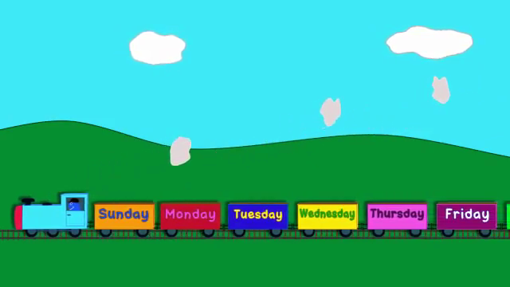
WELCOME

Slide 2
Presented by
Hazera Khatun
Head Teacher
Charbata Gov.Primary School
Subornachar, Noakhali.

Slide 3
Sub: English
Class-2
Time-40 minutes
Unit 4: Days of the week.

Slide 4
Learning outcome
Students will be able to say the names of seven days in a week.

Slide 6
Lesson 1:days (1)
Page-22

Slide 7



Look ,Listen and say.
Wcw / drill
Sunday
Thursday
Monday
Friday
Tuesday
Saturday
Wednesday

Slide 8




Listen and say with teacher
T- Sunday
Ss-Sunday
T- Monday
Ss-Monday
T- Tuesday
Ss-Tuesday
T- Wednesday
Ss-Wednesday
T- Thursday
Ss-Thursday
T- Friday
Ss-Friday
T-Saturday
Ss-Saturday

Slide 9

Pair work
S1----Sunday
S1--Thursday
S2---Monday
S2--Friday
S1--Tuesday
S1--Saturday
S2--Wednesday

Slide 10
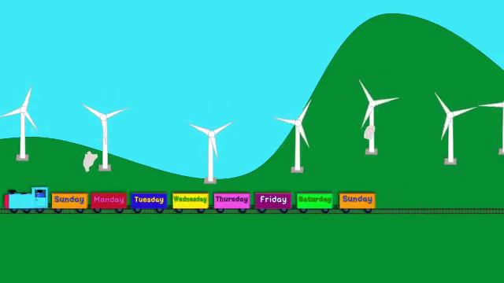
THANK YOU

